Slide 1
External Go Live Communication
We are excited that you have gone live, and want to help you share it with your peers!

Slide 2
How to create a Social Card for Linked In - Step by step guide
All you need to do for the social cards is add your company logo to the top left or right corner. (If desired)
To save the slide as a picture ready to post follow these steps:
1. Select the slide you wish to save
2. Click File > Save as > Save as JPEG from dropdown menu > Save > select just this one > Save
3. Start a new post in LinkedIn and add the image to your LinkedIn post and feel free to tag:
#sapconcur, #GoLive #SAPConcurGoLive and if you like tag @sapconcur, and our UKI Enterprise MD Rob Harrison, Services VP Stephanie Bethgnies and Services Director Gogan Sharma
If you want to add a quote or fact please do so in the text boxes provided. If not please remove the text box.

Slide 3
We’ve Gone Live With SAP Concur

Slide 4
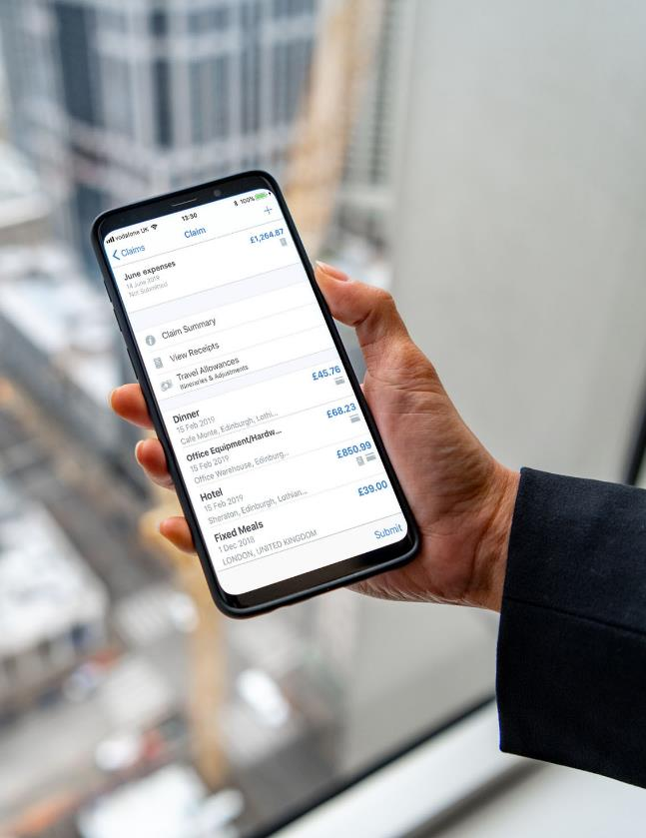
We’ve Gone Live With SAP Concur!
Insert fact or quote here if desired. If not please delete this text box

Slide 5
We’ve Gone Live With SAP Concur!
Insert fact or quote here if desired. If not please delete this text box

Slide 6
We’ve Gone Live with SAP Concur!
Insert fact or quote here if desired. If not please delete this text box

Slide 7
We’ve Gone Live With SAP Concur
Insert fact or quote here if desired. If not please delete this text box

Slide 8
We’ve Gone Live With SAP Concur
Insert fact or quote here if desired. If not please delete this text box

Slide 9
We’ve Gone Live With SAP Concur

Slide 10
We’ve Gone Live With SAP Concur

Slide 11
We’ve Gone Live With SAP Concur

Slide 12
We’ve Gone Live With SAP Concur

Slide 13
We’ve Gone Live With SAP Concur

Slide 14
We’ve Gone Live With SAP Concur

